Slide 1

Spain Energy Deficit Insights
Ni-Ke

Slide 2




Team-Ni-Ke
Ken Carson, CEO
James Beta, CTO
Bash Ashafa, CCO
Joe Mugo, CPO
The team lead
Data Scientist-13 years
Project lead
Data Scientist -12 years
Communications lead
Data scientist 12 years
Research lead
Data Scientist 10 years

Slide 3
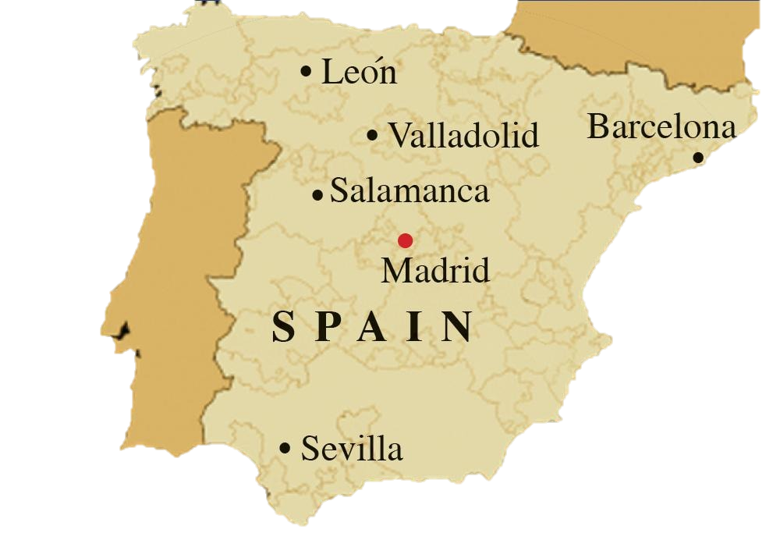
Introduction
Spain is experiencing intermittent power deficits due to an increased population that has caused a rise in demand for energy. As such, Espinoza; a high Spanishh government official working in the energy department has approached Ni-Ke with the data her government has been collecting over a period of 3 years in 5 of Spain’s cities for analysis and a predictive model building.

Slide 4
Understanding the problem
Problem 1
Problem 2
Problem 3
To maintain and improve the standard of living by investing in electricity infrastructure.
To analyze the trends and patterns of the country's renewable sources and fossil fuel energy generation.
To model the shortfall between the energy generated by means of fossil fuels and various renewable sources

Slide 5

Problem Statement
Power outages due to deficiencies in energy production, weighs on the Spanish government’s mandate to improve the Spaniards living standard as their top priority. They hired Ni-Ke to show the trends & patterns that the renewable energy sources data has and to build a predictive model.

Slide 6
Exploratory Data Analysis
The content:
Data content
Data Patterns
Data Visuals

Slide 7


Brief Review
Non renewable energy is depleting and the heavy reliance to it creates a growing deficit
Renewable energy on the other hand is perpetual and the ability to tap it creates a sustainable resource
RENEWABLE SOURCES EXAMPLES
WIND
GEOTHERMAL
SEA
WIND
SOLAR

Slide 8

Factors
Wind speed
Wind direction
Temperature
Rainfall
Humidity
Cloud coverage
Snow fall
Renewable Energy
Notes:
These are the factors affecting renewable sources

Slide 9
Fun facts
Coal only generates 29% of its original value in energy. But wind power generates 1,164% of its original value!
An hours’ worth of sun power is enough to meet the energy needs of the entire planet for a year
Costa Rica are already running on 100% renewable energy
Coal only generates 29% of its original value in energy. But wind power generates 1,164% of its original value!
Renewable Energy Sources Generated 38% of the Global Electricity in 2021
Coal only generates 29% of its original value in energy. But wind power generates 1,164% of its original value!
Wind energy is the largest source of renewable power in the UK
One wind turbine can power up to 1,500 homes for a year
Notes:
Read the 1st ones, right and left.

Slide 10
Data Content
Missing
Training data
46 numerical features
3 categorical features
1 column with 2068 missing entries(23.6%)
8763 entries in total
Test Data
1 column with 454 missing entries(23.6%)
2920 entries in total
Available
2068
454
8763
2920
Test Data
Train Data

Slide 11
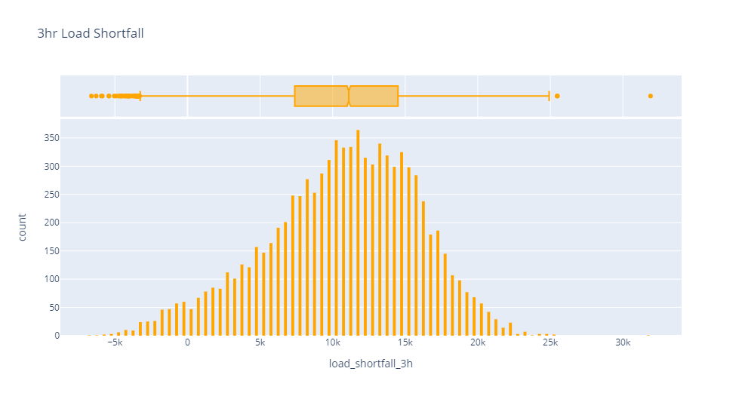

Slide 12
Data Patterns
Target Variable
The target variable was found to have a normal distribution with a skewness of -0.38.
There outliers in this variable were few and acceptable for a model build up. The lowest datapoint being -6618 and the highest being 31904(which seems to be a bit outrageous).
The features with the strongest correlation with the target variable both positive and negative are Valencia_temp_min and Sevilla_humidity respectively. (0.2 & -0.17 respectively)

Slide 13
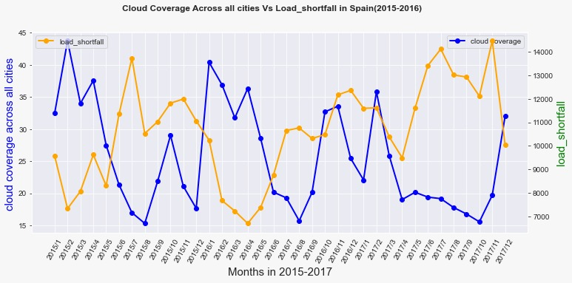
Data Visuals
Data Visuals
Relationships with Shortfall.
Relationships with Shortfall.
Cloud Coverage

Slide 14
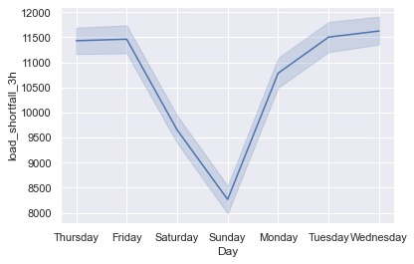
Data Visuals
Data Visuals
Relationships with Shortfall.
Relationships with Shortfall.
Cloud Coverage
Day-of-the -week

Slide 15
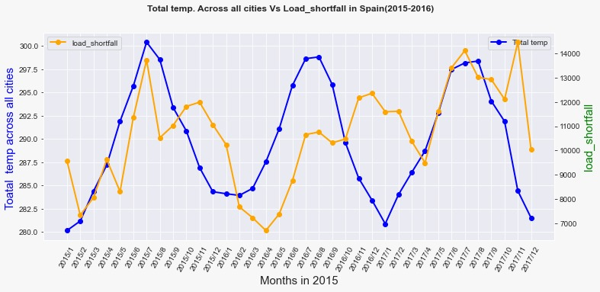
Data Visuals
Data Visuals
Relationships with Shortfall.
Relationships with Shortfall.
Cloud Coverage
Cloud Coverage

Slide 16
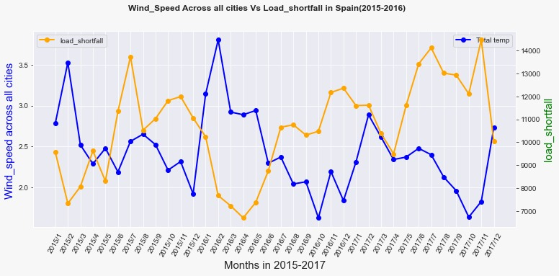
Data Visuals
Data Visuals
Relationships with Shortfall.
Relationships with Shortfall.
Cloud Coverage
Cloud Coverage

Slide 17
Feature Engineering
Data was preprocessed and engineered with new features e.g. year, month, day and seasons creating optimal data for building a predictive model.
Notes:
We then moved to creating several models and training them with the preprocessed data.

Slide 18
Proposed Models for Shortfall Predictions
Linear Regression
Measure of Accuracy(RMSE)
Decision Trees
Measure of Accuracy(RMSE)
Random Forests
Measure of Accuracy(RMSE)
Best Performing Model
Random Forests Model based on the highest accuracy.

Slide 19
Table of accuracy
Model
 |  |  | Pro Con
Prediction Error (RMSE)
Linear Regression
4686.47
Advanced projects
Decision Trees
4574.26
Random Forests
4377.38

Slide 20
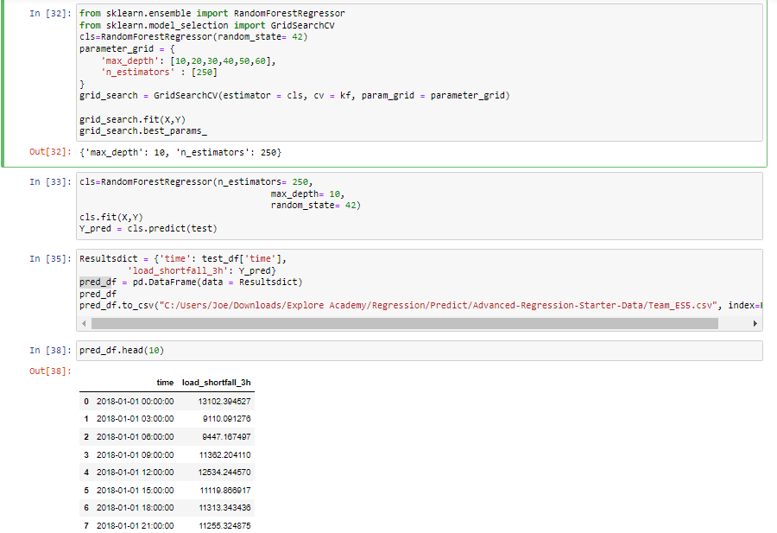
Pro Con
Random Forests

Slide 21
Conclusion
Based on the analysis of the trends and patterns from the three years’ data, a predictive model was created. The model maps the effect of the set of weather conditions to predict the deficit of the renewable energy in comparison to Spain’s fossil energy. Hence, with this information the Spanish government can strategically place investment into the relevant infrastructure to improve production of clean and sustainable electricity and consequently the quality of life for its citizens

